Slide 1
Project 3:
Understanding Climate Change and California Fires
Presented By:
Adhithi Raghavan
Alexandre Lazzari
Edward Tagaca
Marison Cornejo
Taylor Griggs
Utilizing Data By:
NASA Temperature:
California Fire Data
Notes:
Taylor

Slide 2
Project Overview
Introduction
Hypothesis
Global Heat Map
Fire Heat Map Over The Years
Conclusion and Correlation
Data Sources
Notes:
Taylor

Slide 3
Introduction
With the increase in wildfires that has been observed in California, we wanted to understand the effect that climate change is having in the explosive growth of the number of fires.
Notes:
Adhithi
As the Earth's average temperature creeps upward, climate scientists have predicted record heat waves and droughts. That's what we've seen this summer in the U.S.
https://www.npr.org/2023/08/30/1196637141/climate-change-makes-wildfires-in-california-more-explosive#:~:text=Now%20a%20new%20study%2C%20published,vast%20amounts%20of%20fossil%20fuels.

Slide 4
Hypothesis
Because global temperatures are increasing year after year from 1980, the air is getting hotter and hotter
This results in a vapor pressure deficit and as the air is hotter and drier, it causes fires to grow much bigger
Let’s take a look through our data and the correlations between temperature increase, the number of acres burned by the largest fire each year from 2000 to 2021
Notes:
Adhithi

Slide 5
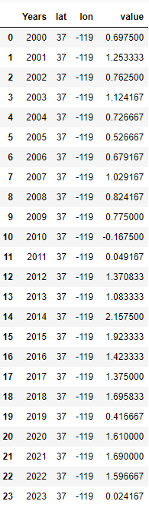
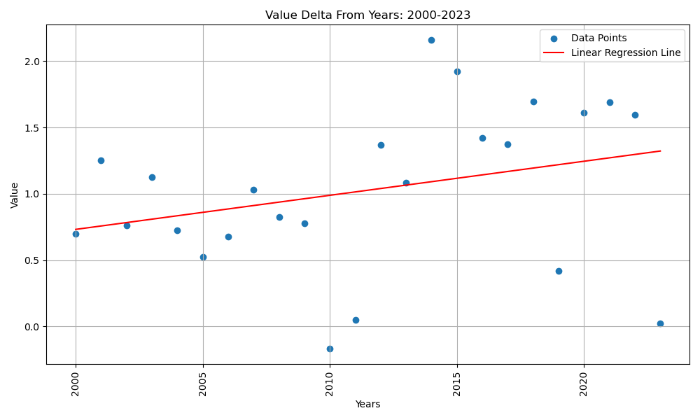
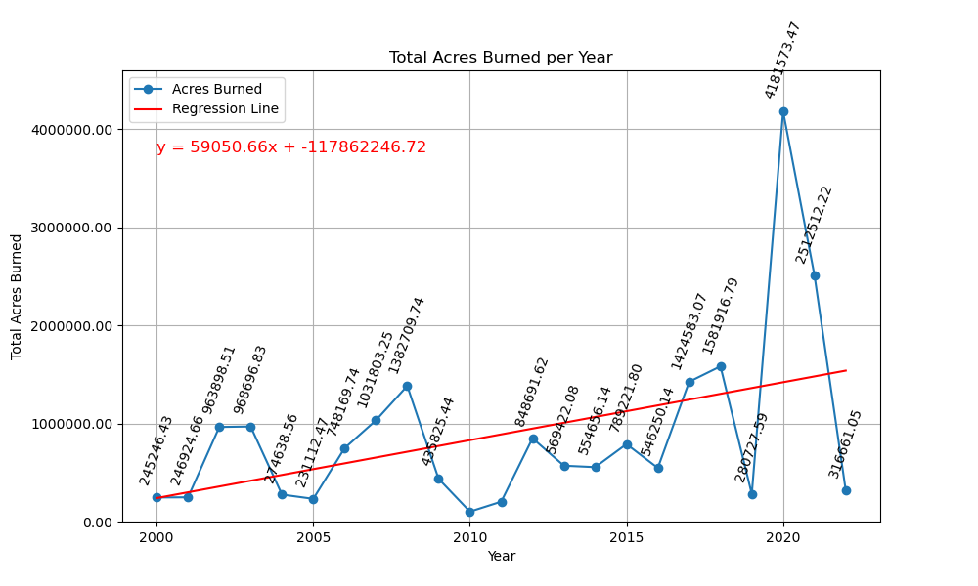
Temperature Increase through the Years
Correlation showing that the increase in temperature is directly proportional to the number of acres burned
Notes:
Taylor Talks on delta in lin reg and then hands to Alexandre

Slide 6
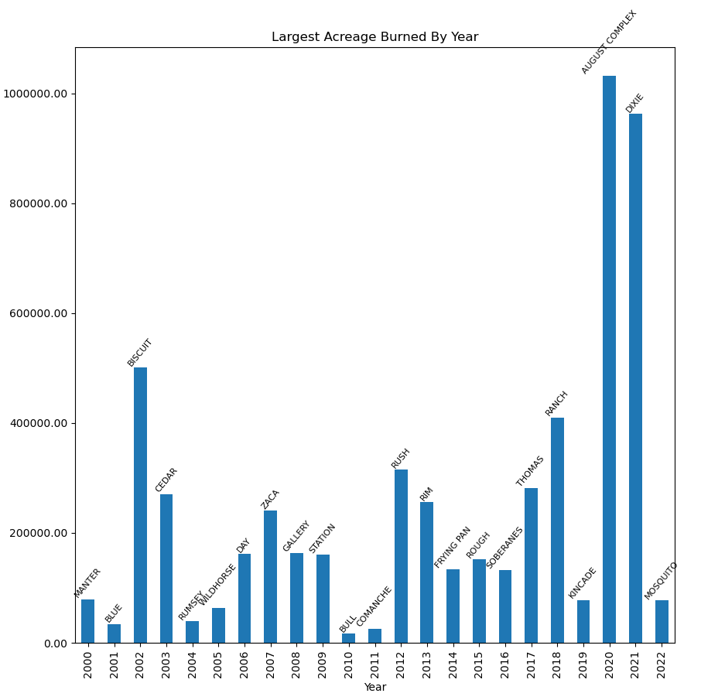
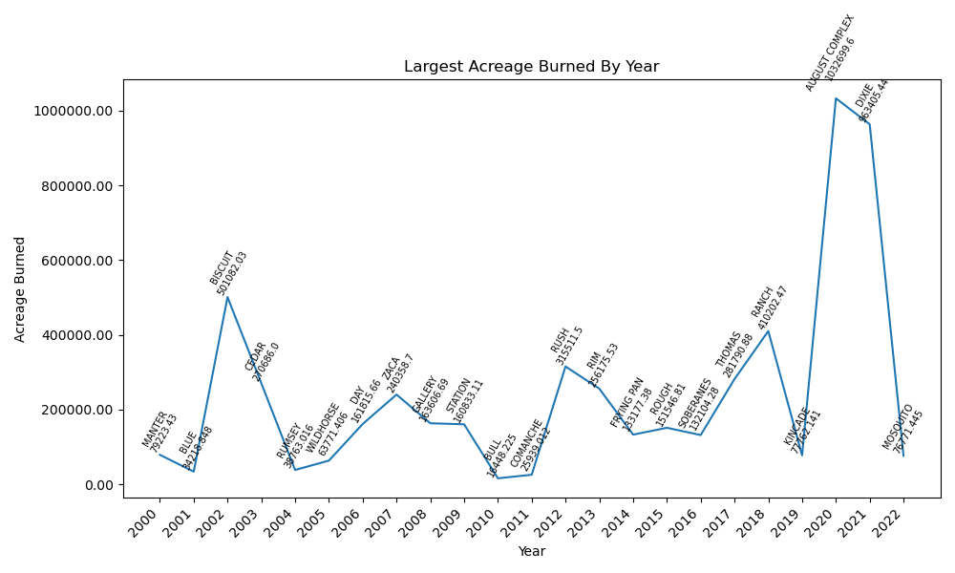
Acres Burned in California through the Years
Notes:
Alexandre

Slide 7
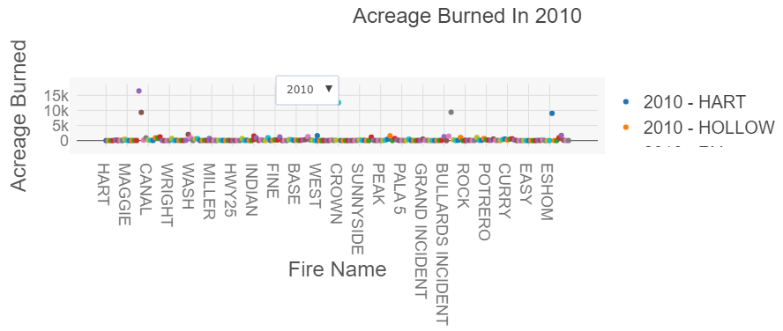
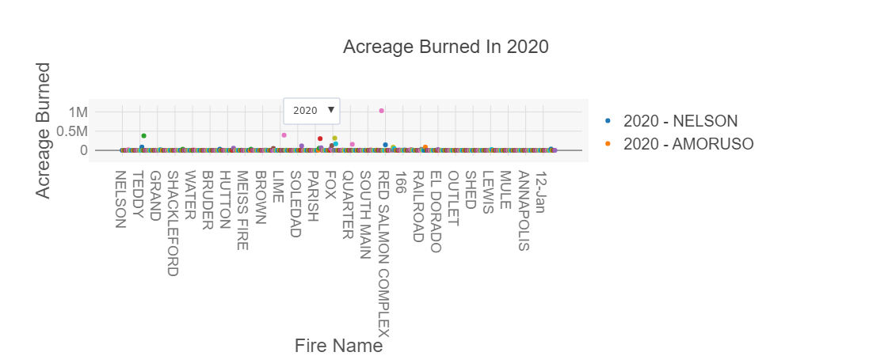
Smallest and Largest Acreage Burned 2000-2022
In the 20 years 2010 had the lowest total acreage burned in the year.
2010 had a negative temperature change making it the coolest year.
2020 had the largest amount of total acreage burned.

Slide 8
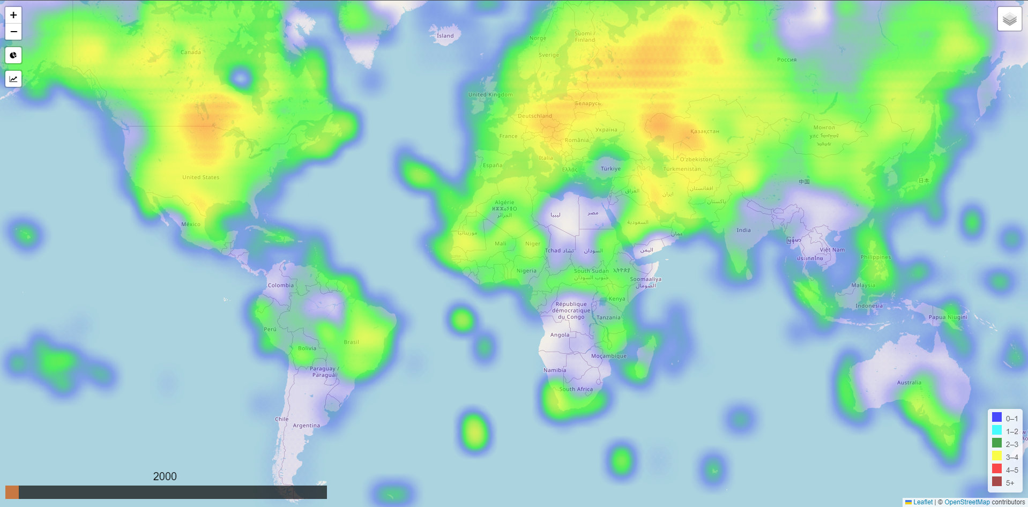
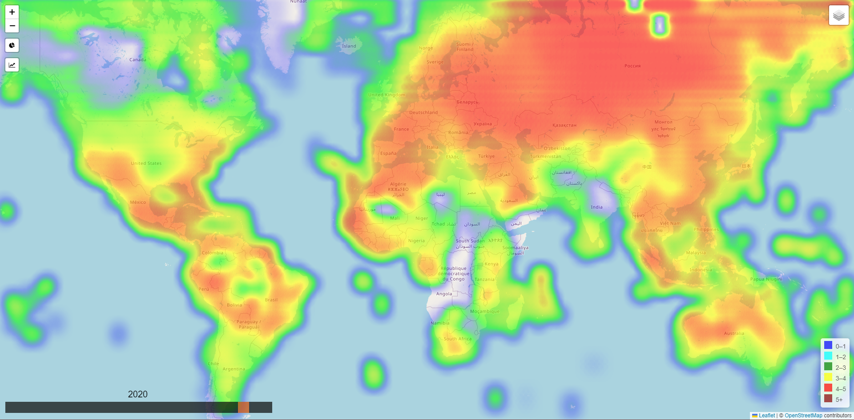
WORLD HEAT MAP (2000)
WORLD HEAT MAP (2020)
Notes:
Edward -

Slide 9
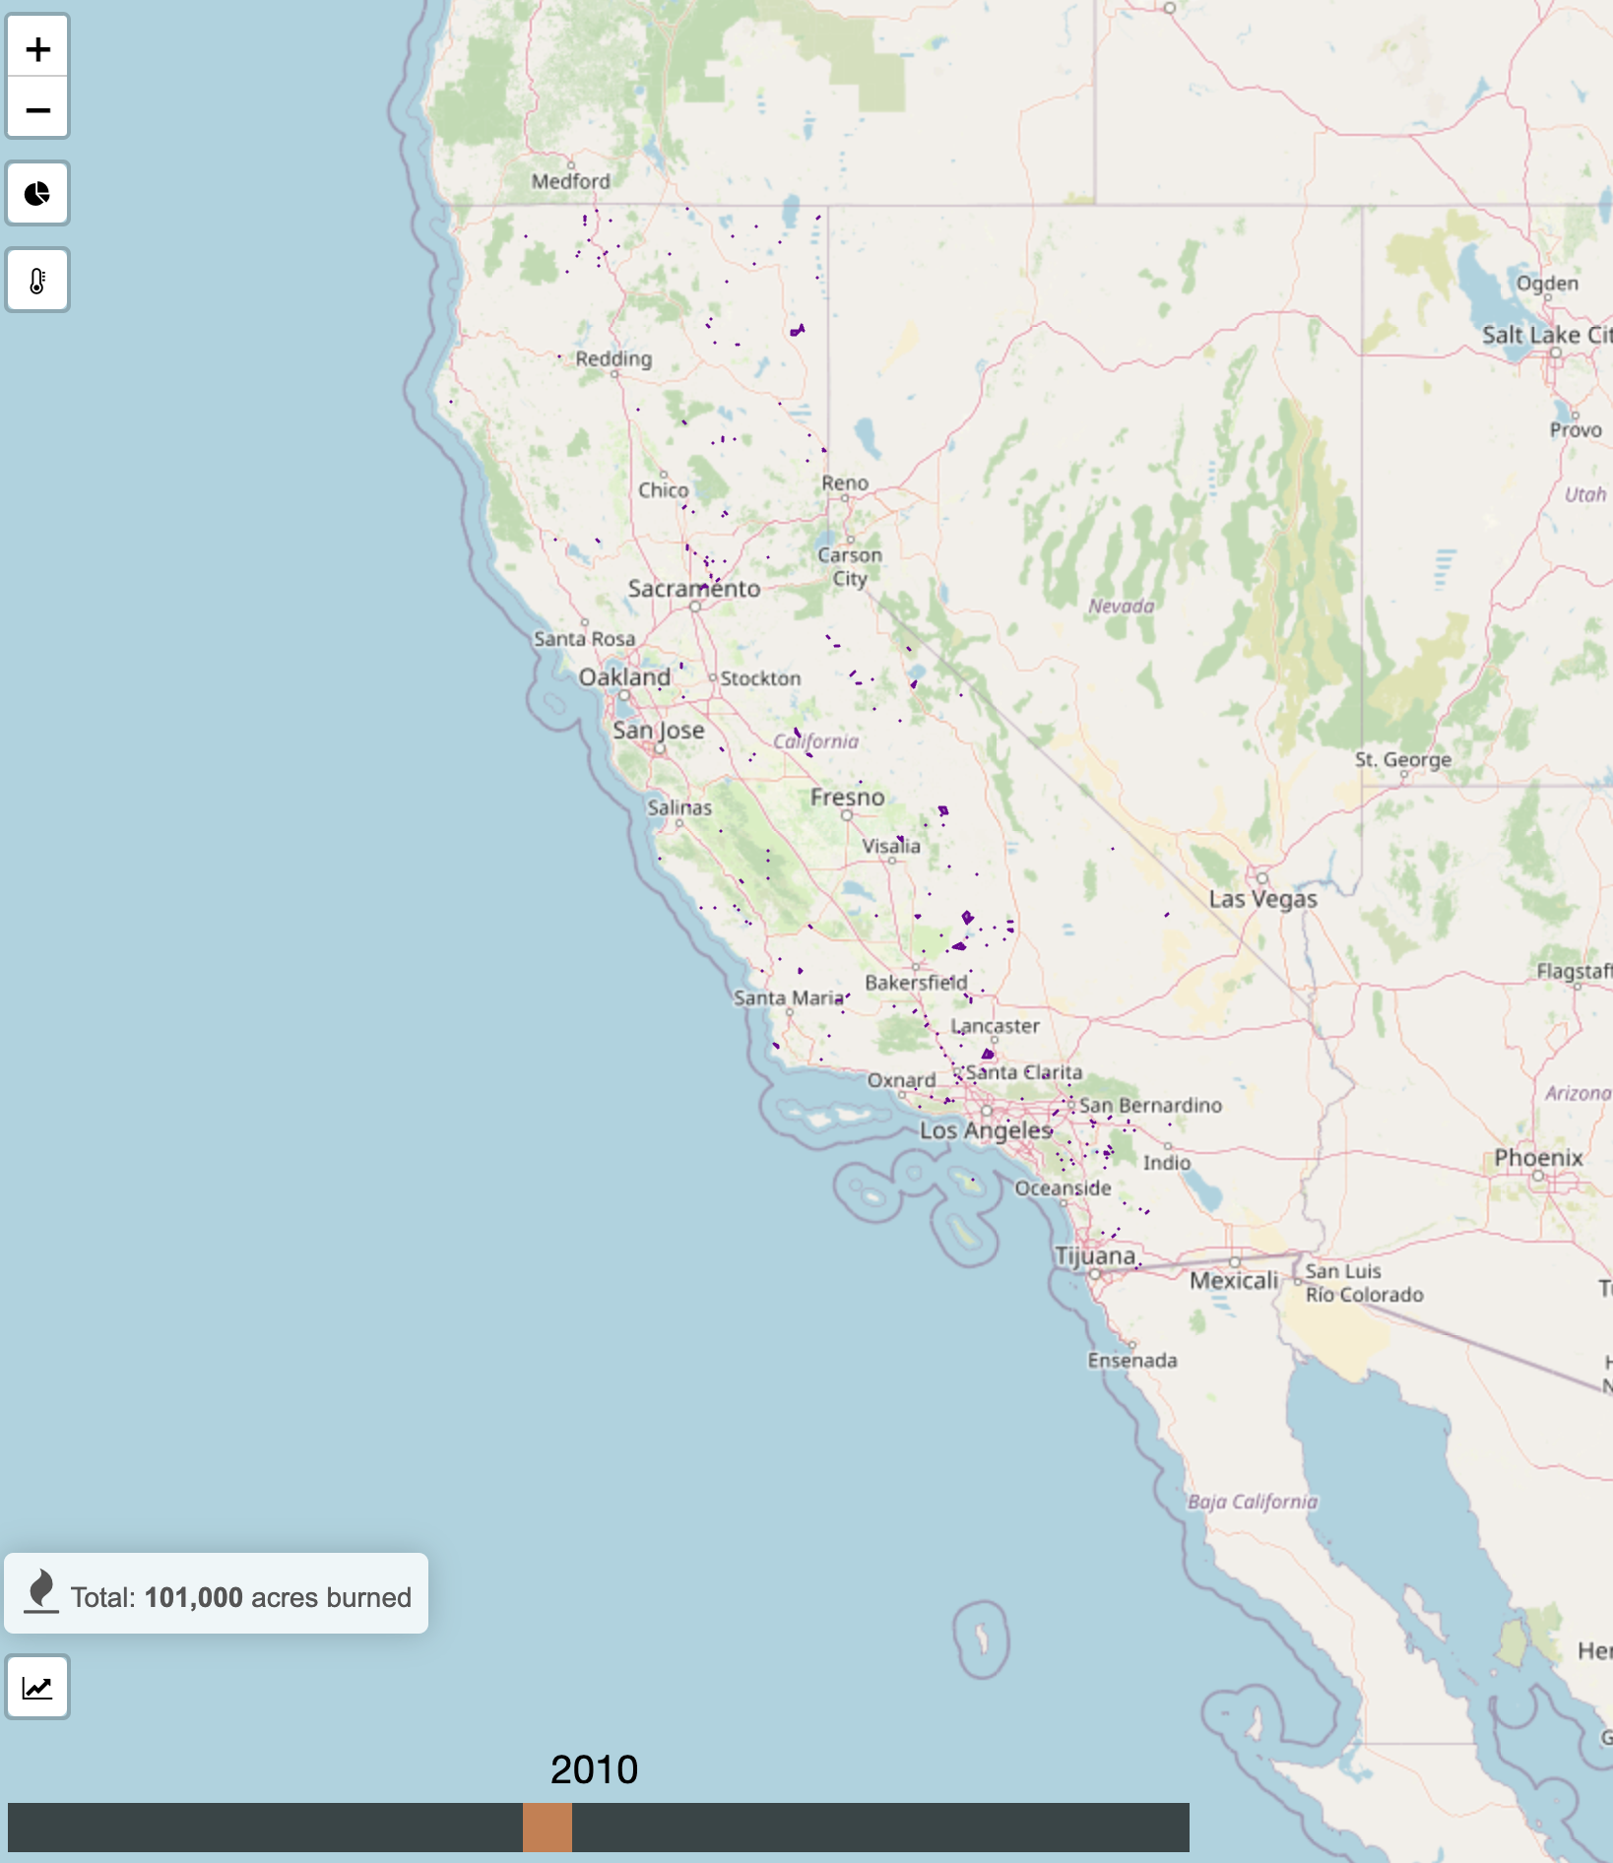
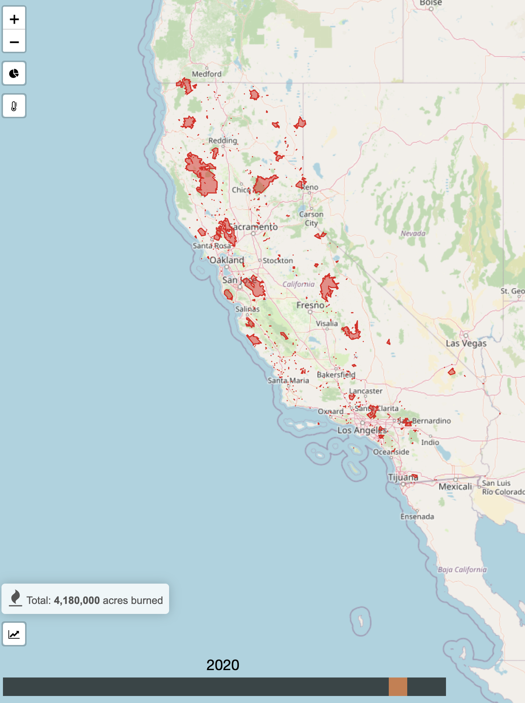
Acres Burned in California (2010)
Acres Burned in California (2020)
Notes:
Edward -

Slide 10
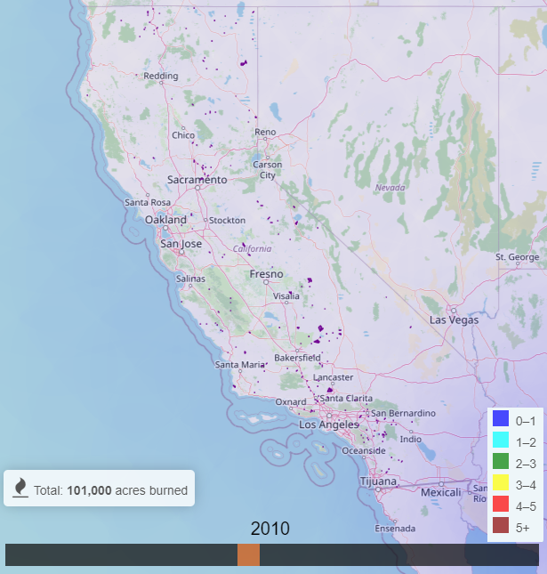
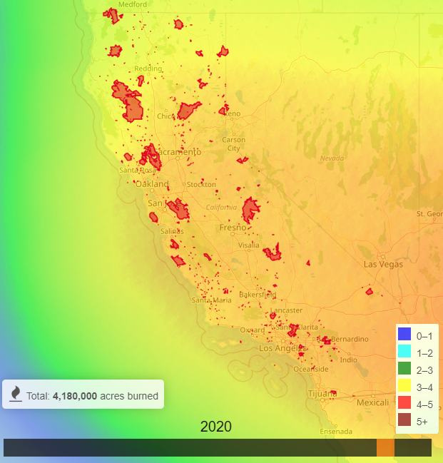
Correlation
Temperatures and acres burned and temperature
Notes:
Edward -

Slide 11
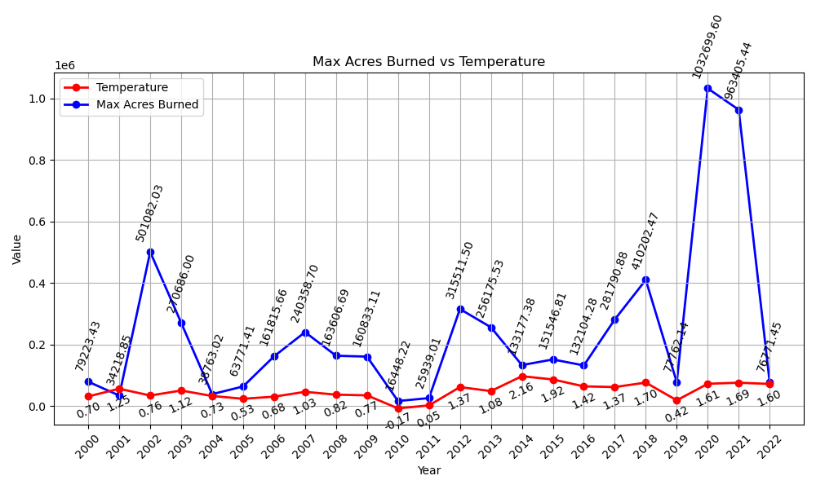
Acres Burned vs Temperature
Temperature and acreage burned show a consistent correlation.
Generally, higher temperatures correspond to increased acreage burned, and vice versa.
Notably, in 2002, despite a decrease in temperature, it recorded the highest acreage burned in that decade.
Notes:
Alexandre

Slide 12
Demo
Notes:
Marisol - showing the interactive visualization of the heat map and the layers

Slide 13
Data Sources
https://data.giss.nasa.gov/gistemp/
Delta in temperature change from the average temperature from 1951-1980 to the year selected
https://gis.data.ca.gov/maps/e3802d2abf8741a187e73a9db49d68fe/about
This data includes all of the fires recorded in California up to the year 2022.
Notes:
Adhithi
Our first step for this project was determining where to acquire the data; We were able to get temperature data from the NASA Goddard Institute for Space Studies that shows data being collected starts in 1900. The base temperature is normalized The data is showing

Slide 14
Thank You

